Slide 1
Machine Learning Approaches for Predicting Insurance Premiums and Claim Occurrences
Team Details
DSE Jan’25 Group 1- Team Members
Mr. Santhosh Kumar Sundareswaran
Mr. Kumara Vijay M G,
Mr. Rohan Sudhir
Mr. Kaushik A
Ms. Sivaranchani Senthilkumar

Slide 2
Problem Statement
The objective is to build robust machine learning models to predict insurance premiums and estimate claim occurrences for motor policies.
Key Goals
Set fair, data-driven premiums to remain competitive without eroding profitability.
Anticipate claim liabilities with higher precision.
Enhance underwriting decisions through accurate risk profiling.
Reduce operational inefficiencies in claims handling.
Market Challenge
In the competitive insurance market, mispricing premiums can lead to driving away low-risk customers (overpricing) or attracting high-risk ones (underpricing), both of which harm profitability. Inaccurate claim forecasting can lead to under-provisioning, causing liquidity issues, or over-provisioning, which ties up capital unnecessarily.

Slide 3
Suggested Solution
The proposed solution involves leveraging machine learning and data mining techniques to develop an intelligent system for comprehensive insurance premium prediction and claim analysis. By utilizing a rich dataset, the aim is to build predictive models that can predict possibility of claim with greater accuracy.
Data-driven Risk Assessment: Developing models to identify high-risk policies or customer segments based on attributes like driver age, vehicle value, policy coverage type, and geographical factors.
Optimized Claim Possibility: Creating models that can predict the potential customer who will claim based on a multitude of features, enabling better financial provisioning.
Enhanced Premium Prediction: Implementing regression models to predict the premium amount applicable for a specific customer profile more accurately.

Slide 4
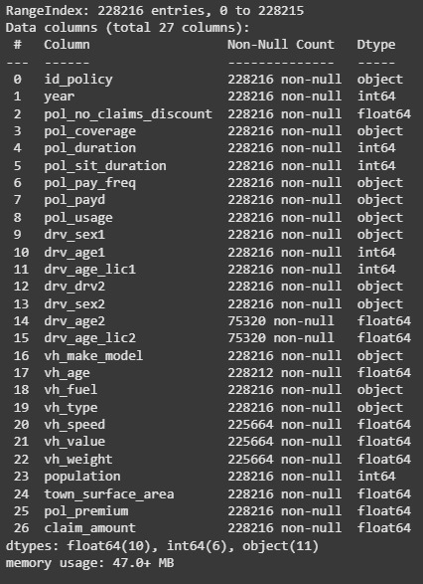
Understanding the data

Slide 5
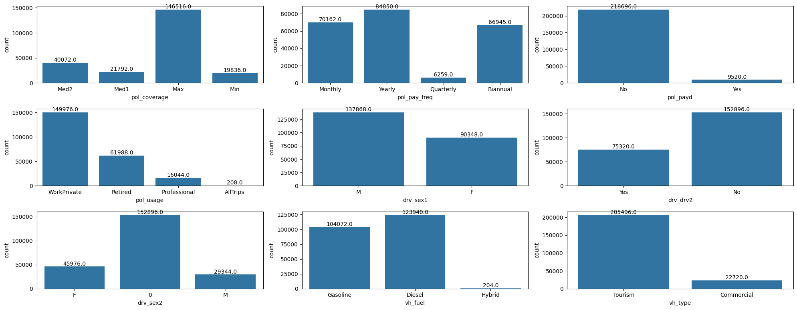
Univariate Analysis - Categorical

Slide 6
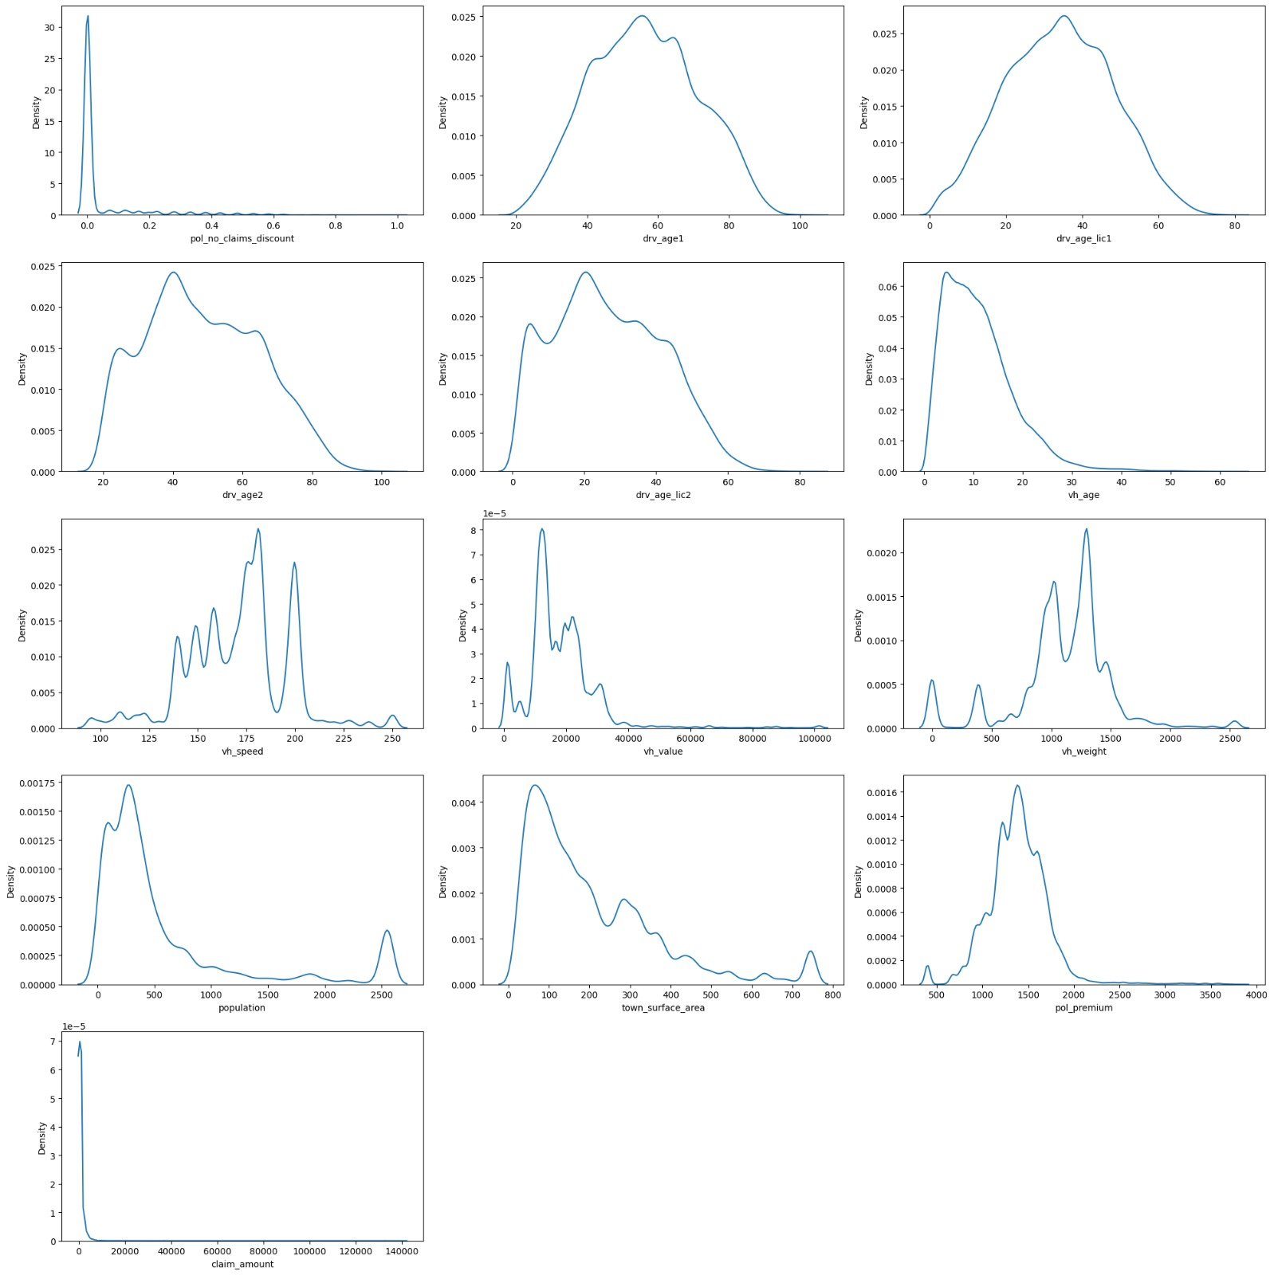
Univariate Analysis - Numerical

Slide 7
Missing/Null Values
Missing values were identified predominantly in columns related to the secondary driver (drv_age2, drv_age_lic2) and some vehicle characteristics (vh_age, vh_speed, vh_value, vh_weight).
drv_age2, drv_age_lic2- If a policy does not have a drv2, the values in field related to drv2 are marked as null, these null values are replaced with -1 indicating that it is not applicable.
vh_age-The vh_age missing values are from the same policy holder, the 4 years data of the same policy will just have age increment by 1 for each year. Imputation is needed for only one value which can be incremented for the other values. Upon filtering the database by vehicle_make_model, year, pol_usage, pol_coverage, drv1_sex, pol_pay_freq as in the missing row and calculated the median of vh_age which was logical.
vh_speed, vh_value, vh_weight – The missing values were dropped as they contributed to only 1.1% of the data and did not have any significant impact.
The heat map below provides a visualization of the null values spread across the dataset.

Slide 8
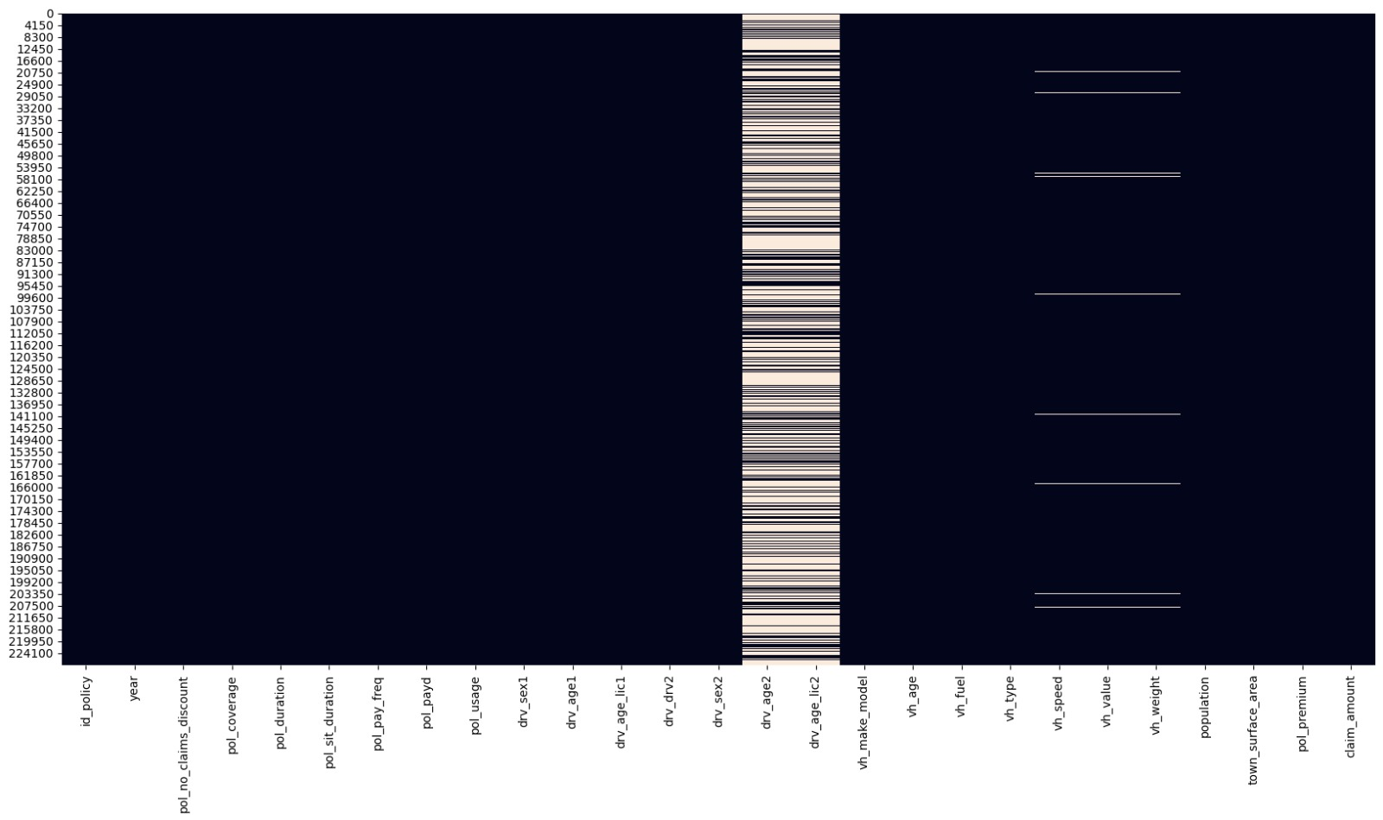
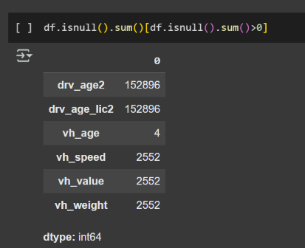
Missing/Null Values

Slide 9
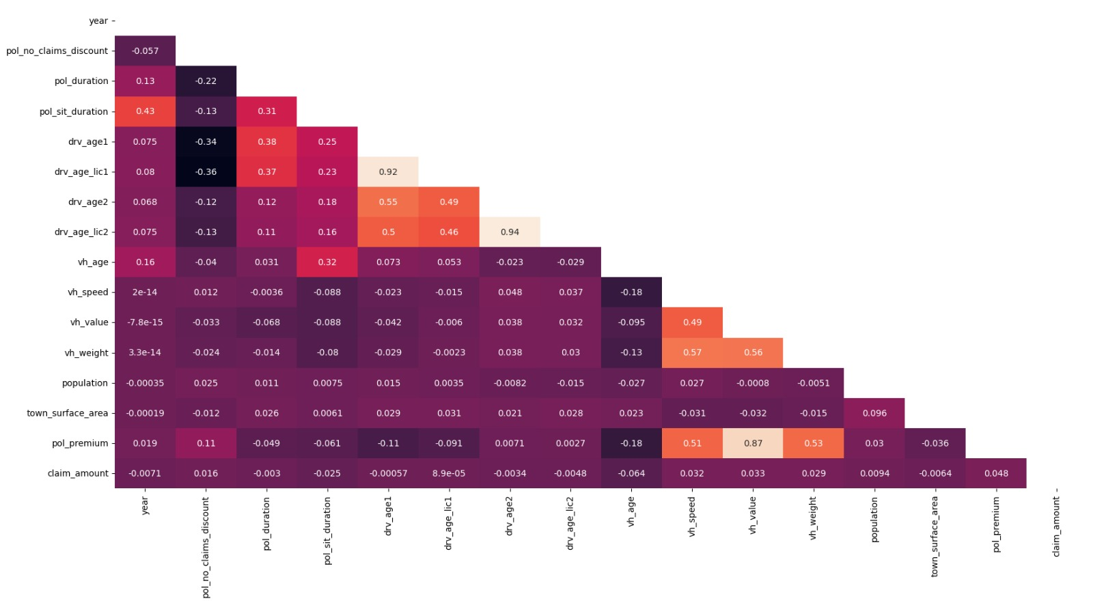
Correlation Analysis
Initial Pearson correlation analysis was performed to identify linear relationships between individual features (including engineered ones) and claim_amount. Although most individual correlations were weak, this step helps in understanding potential direct impacts.

Slide 10
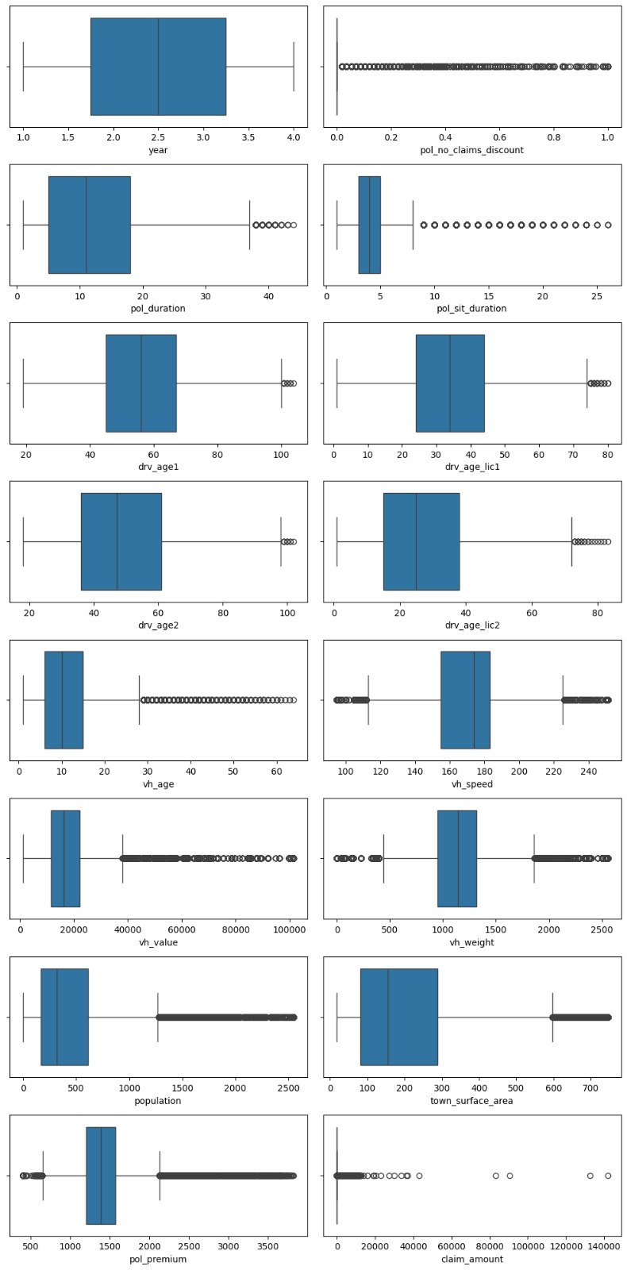
Outliers
Outliers: A significant number of outliers were detected across various numerical columns, including
claim_amount (23,292 outliers)
pol_premium (6,113 outliers)
pol_no_claims_discount (43,937 outliers)
drv_age2 (75,320 outliers)
population (27,736 outliers), utilizing the Interquartile Range (IQR) method. These outliers necessitate careful handling to avoid biasing models.
Even though the outliers are present in most of the numerical columns, they cannot be ignored as they are legitimate outliers needed for model training.

Slide 11
Feature Engineering
Claim Occurrence Flag – Binary indicator (1 for positive claim_amount, 0 otherwise) enabling a two-stage modeling approach.
Population Density (pop_den) – Derived from population / town_surface_area to reflect urban accident risk; original columns dropped.
Primary Driver Experience (drv1_exp) – Years of driving experience (drv_age1 − drv_age_lic1); original drv_age_lic1 dropped.
Driver Age Binning (drv_age1_bin) – Categorized into Young Adult, Middle Aged, Old, and Senior Citizen to capture non-linear risk.
No-Claim Discount Trend (ncd_trend) – Categorized as No History, Increased, Decreased, or No Change based on year-on-year changes; original discount columns dropped.
Vehicle Power-to-Weight Ratio (vh_power_to_weight) – Calculated from vh_speed / vh_weight (zero weights replaced by median); original columns dropped.
Vehicle Age Binning (vh_age_bin) – Grouped into Road Worthy (0–15 years) and Old Vehicle (>15 years).
Policy Usage × Vehicle Type (pol_usage_vh_type) – Combined categorical feature to capture usage-risk patterns; originals dropped.
Vehicle Make/Model Encoding (vh_make_model_encoded) – Frequency encoding applied to ~975 hashed categories; original column dropped.

Slide 12
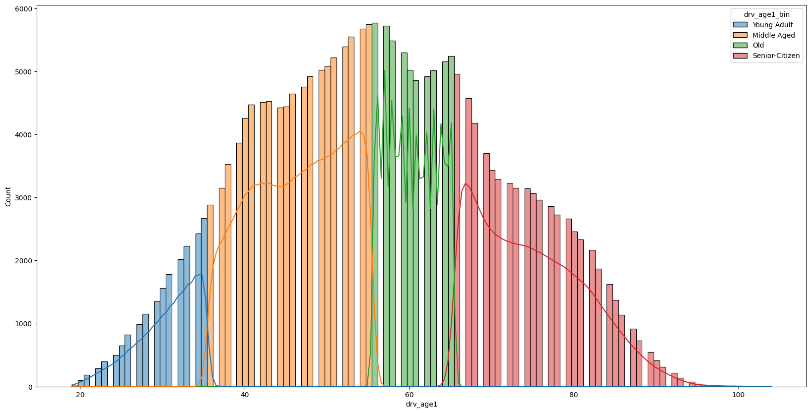
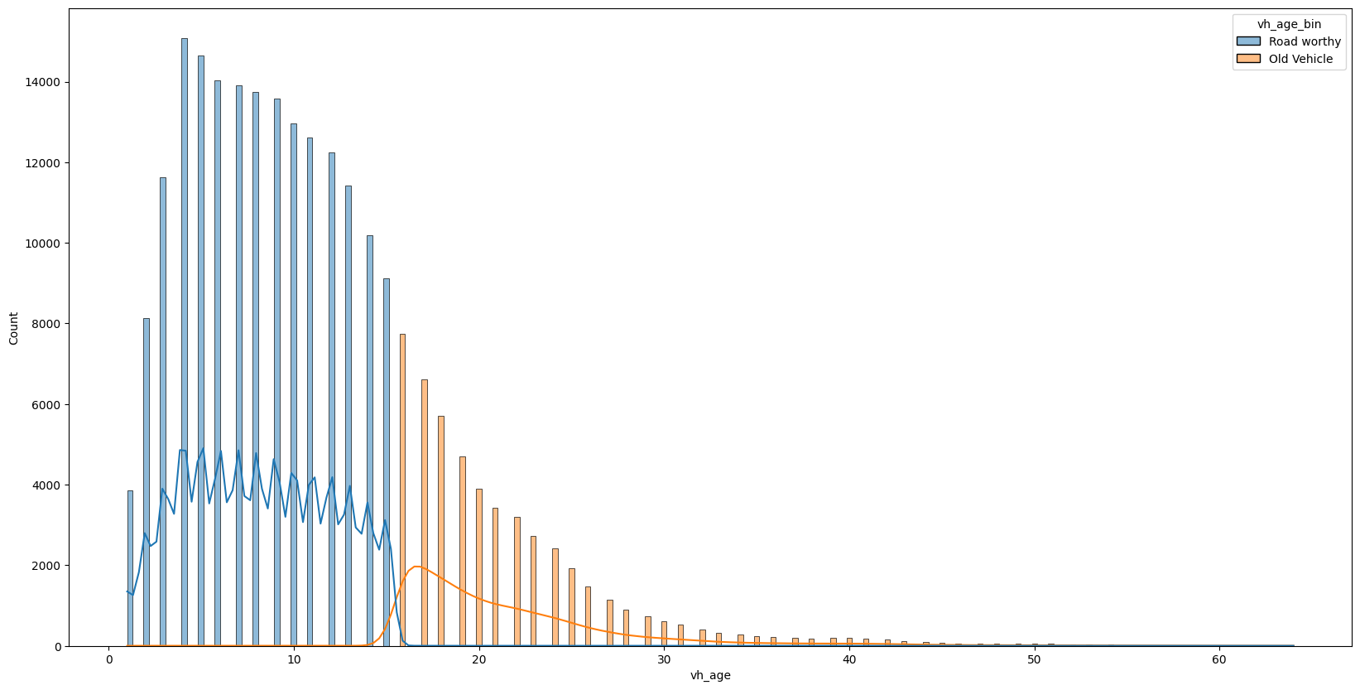
Driver1 age bins
Vh_age bins

Slide 13
Statistical Analysis
To identify statistically significant relationships between various features and the claim_amount using ANOVA (Analysis of Variance).
Our analysis revealed strong statistical relationships (p-values often close to 0) between claim_amount and several key features, indicating that these factors significantly influence the claim amount.
Policy-related factors: pol_coverage, pol_pay_freq, pol_payd, and pol_usage all show a significant relationship with claim_amount.
Driver-related factors: drv_sex1, drv_drv2, and drv_age1_bin are significantly related to claim_amount.
Vehicle-related factors: vh_make_model, vh_fuel, vh_type, and vh_age_bin also exhibit a significant relationship with claim_amount.
For relation between numerical variables and the claim_amount we have previously seen the correlation matrix that shows the non-linear relationship between the variables.

Slide 14
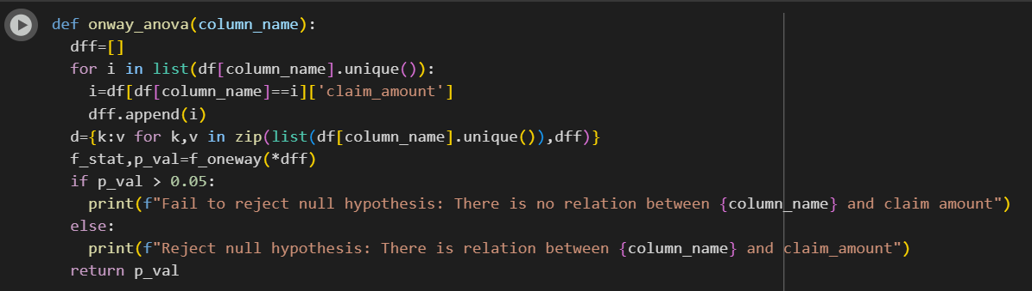
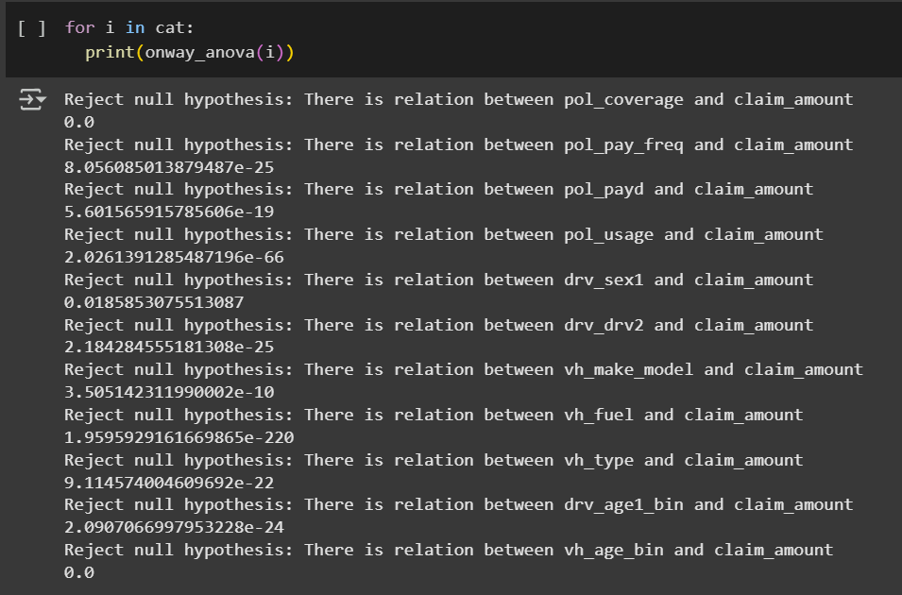
Function created for ANOVA test
ANOVA test results

Slide 15
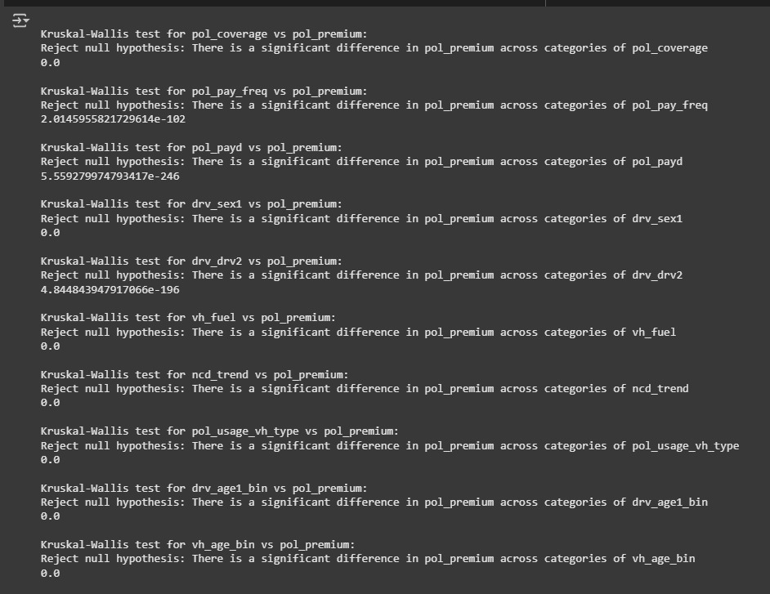
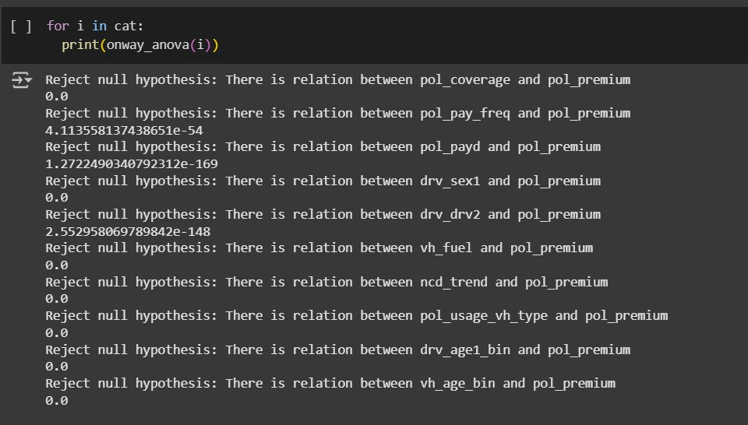
KRUSKAL WALLIS test
ANOVA test results

Slide 16
Encoding
One-Hot Encoding :
For the main predictive modeling dataset, One-Hot Encoding (OHE) was applied to convert categorical features into a binary matrix format, ensuring that models could process them without imposing any false ordinal relationships
Many of the selected models (e.g., Logistic Regression, XGBoost, LightGBM with certain parameters) perform better when categorical variables are expanded into binary features.
Prevents introducing artificial ranking between categories such as pol_coverage (Min, Med1, Med2, Max) or vh_fuel (Gasoline, Diesel, Hybrid).
Preserves the full variability of the original feature without losing interpretability.
Applied to nominal features like pol_coverage, pol_pay_freq, pol_payd, drv_sex1, drv_drv2, drv_age1_bin, vh_age_bin, vh_fuel, and pol_usage_vh_type.
Implemented during preprocessing so that both classification (claim occurrence prediction) and regression (premium prediction) pipelines received consistent encoded inputs.

Slide 17
Addressing Multicollinearity with Variance Inflation Factor (VIF)
High multicollinearity was detected among the predictor variables, which can inflate the variance of the regression coefficients and make them unstable.
We used the Variance Inflation Factor (VIF) to quantify the severity of multicollinearity.
A VIF value greater than 10 is a common rule of thumb to indicate problematic multicollinearity.
The initial VIF calculation showed very high values for several features, indicating
Significant multicollinearity. For example, 'drv_age2 had VIF value of 87.81 .
To address this, we iteratively removed features with high VIF values. The following features were dropped:'drv_age2','pol_usage_vh_type_WorkPrivate_Tourism’ &
'year'.

Slide 18
CUSTOMER PROFILING
Segmentation Basis – Profiles created using demographic, geographic, policy, and vehicle-related features.
Key Variables Used – Population density, driver age bins, driving experience, vehicle age bins, coverage type, and vehicle value.
Clustering Method – K-Means clustering with scaled numerical features and one-hot encoded categorical features.
Optimal Cluster Selection – Determined using Elbow Method and validated with Silhouette Scores.
Profile Insights :
Cluster 1: Low-risk, experienced drivers with modest vehicle values.
Cluster 2: High accident likelihood in dense urban areas.
Cluster 3: High-value vehicle owners with costly claim potential.
Cluster 0: Moderate risk with balanced policy characteristics.

Slide 19
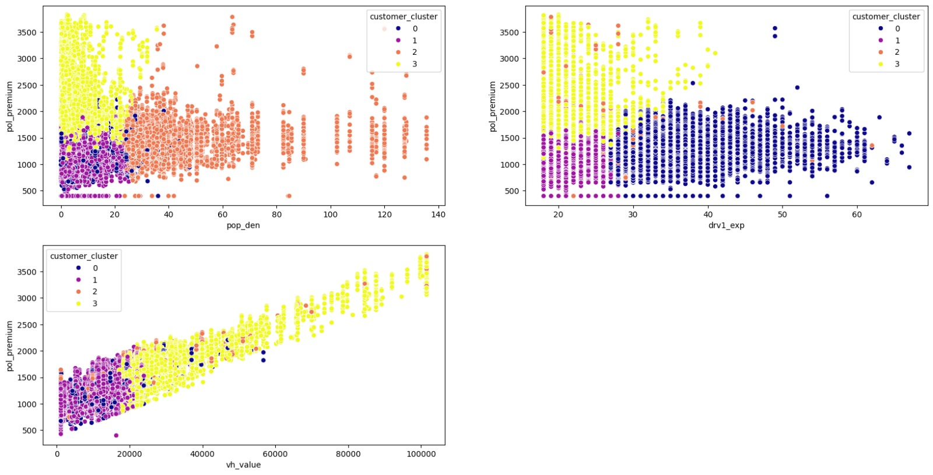
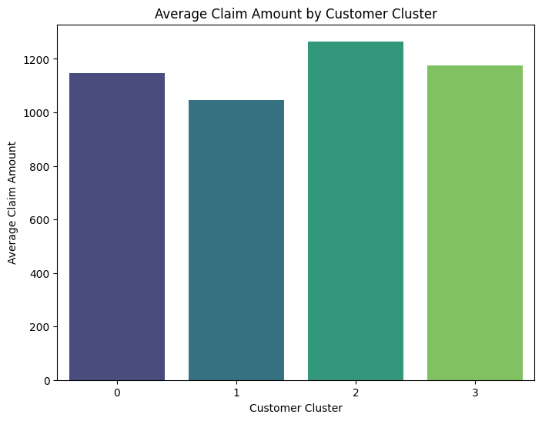

Slide 20
MODEL BUILDING
CLAIM OCCURRENCE PREDICTION

Slide 21
Objective – Predict claim occurrence (binary: claim made or not) as the first stage in a two-stage modeling approach.
Baseline Model – Logistic Regression tested for initial benchmark; showed limited recall for the minority class due to class imbalance.
Tree-Based Models Used :
Random Forest – Handled non-linear interactions well; reduced overfitting risk with ensemble averaging.
XGBoost – High predictive power with gradient boosting; tuned for better handling of class imbalance using scale_pos_weight.
AdaBoost – Sequential boosting approach that improved minority class recall but was sensitive to noisy data.
LightGBM – Fast, efficient, and well-suited for large datasets; achieved best trade-off between precision and recall.
Evaluation Metrics – Accuracy, Precision, Recall, F1-Score.
Key Insight – Tree-based gradient boosting methods (XGBoost, LightGBM) outperformed linear models in capturing complex patterns.

Slide 22
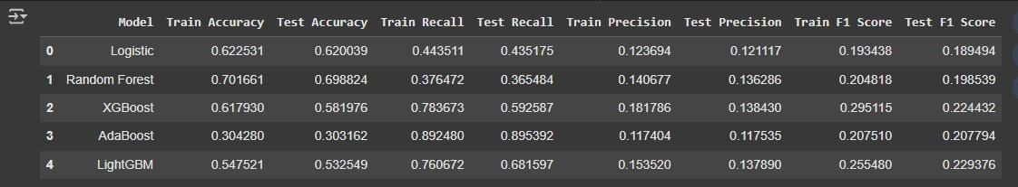
MODEL PERFORMANCE

Slide 23
MODEL BUILDING FOR POLICY PREMIUM PREDICTION

Slide 24
Objective – Predict policy premium amounts as a continuous variable to support accurate, risk-adjusted pricing strategies.
Baseline Model – Decision Tree Regressor tested for initial benchmarking; tended to overfit training data and showed reduced generalization on test data.
Ensemble Regression Models Used :
Random Forest Regressor – Reduced overfitting through averaging; captured non-linear relationships between policy, driver, and vehicle features.
XGBoost Regressor – Gradient boosting approach that provided strong predictive accuracy after hyperparameter tuning.
AdaBoost Regressor – Improved performance over baseline but more sensitive to outliers and noise.
LightGBM Regressor – Fast and memory-efficient; achieved best performance with low MAE and high R² score on test data.
Evaluation Metrics – Mean Absolute Percentage Error (MAPE), Root Mean Squared Error (RMSE), and R² score used for performance comparison.
Key Insight – Gradient boosting methods (XGBoost, LightGBM) excelled at capturing complex interactions without extensive feature scaling.

Slide 25
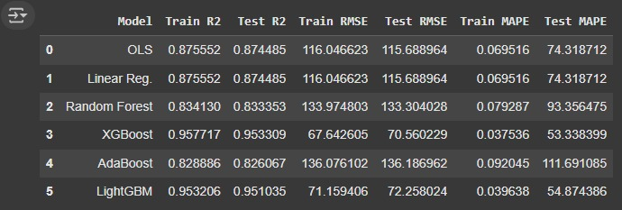

Slide 26
Inference
Successfully developed a two-stage ML pipeline for claim occurrence classification and premium prediction.
Feature engineering significantly improved model performance by incorporating derived variables such as population density, driving experience, and vehicle power-to-weight ratio.
Class imbalance in claim occurrence data impacted baseline models, but boosting algorithms effectively improved minority class recall.
Premium prediction models achieved high R² scores and low error metrics, enabling accurate and consistent pricing.
Customer segmentation using clustering revealed distinct risk profiles, providing actionable insights for targeted pricing and marketing.
Insights support risk-based underwriting, more precise reserve allocation, and enhanced fraud detection capabilities.
The project demonstrates how data-driven strategies can improve profitability, customer satisfaction, and competitive positioning in the insurance market.

Slide 27
Thanks!

